Slide 1
Eurochambres: Digital Working Group Meeting
24 April 2026

Slide 2

Today’s Agenda
Policy state of play
Legal framework
Standardisation
IT system of the DPP
Objectives and expected benefits
Linkages with the European Product Act
Timeline and next steps
Q&A

Slide 3



Digital Product Passport
Policy state of play

Slide 4
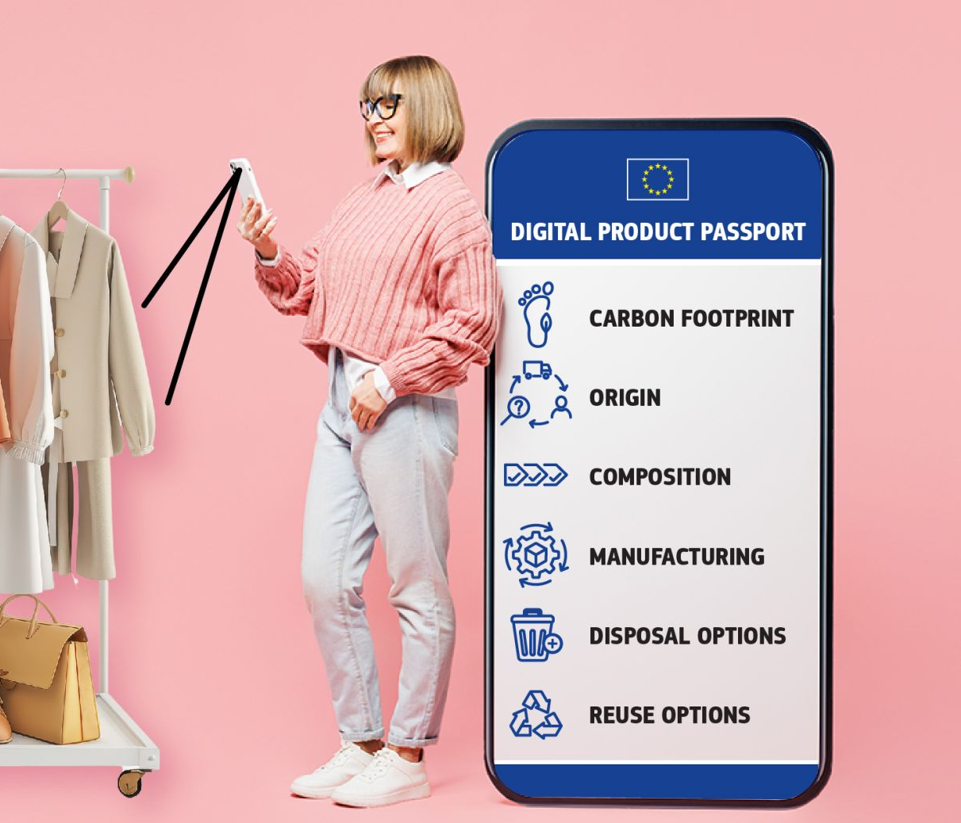
Digital Product Passport
A Digital Product Passport (DPP) is a digital container of product specific information.
It serves as a digital identity for the product, enabling traceability and transparency throughout its value chain.

Slide 5




DPP workstrands
The underlying DPP system will operate uniformly, regardless of the product sector
The Commission coordinates internally to ensure a good alignment between different Commission legislative proposals
Standardisation work is also being undertaken by CEN-CENELEC to ensure interoperability between different elements
The opportunity to integrate horizontal provisions through the New Legislative Framework is being analysed

Slide 6
Digital Product Passport
Legal framework

Slide 7

Legal framework
DPP’s original legal basis can be found in the Ecodesign for Sustainable Products Regulation (ESPR).
It will be complemented through product specific delegated acts (textiles, iron & steel and aluminium, tyres, furniture...).
Other EU Regulations/Directives may include DPP provisions.

Slide 8





DPP secondary legislation
The DPP secondary legislation, which aims to complete the operational framework of the DPP, is planned for adoption as of mid-2026 and includes the following:
  A delegated act setting out the requirements for DPP service providers, as well as a certification scheme to verify their compliance with such requirements where appropriate;
  An implementing act setting out procedures to issue and verify the digital credentials of economic operators and other relevant actors;
  An implementing act setting up requirements for the Central Registry;
  A delegated act establishing rules & procedures on the life cycle management of unique identifiers & data carriers.

Slide 9








Priority products set out in the ESPR Work Programme **
Final products included
Textiles/Apparel
Furniture
Tyres
Mattresses
2027*
2028*
2027*
2029*
Intermediate products included
Products included under the transition rules
Iron & Steel
Aluminium
Energy-related products
ICT products
2026*
2027*
2026 - 2030*
2029*
* indicative timeline for adoption
** Document 52025DC0187, COM/2025/187 final

Slide 10
DPP across sectoral legislation
Regulation | Status | DPP Implementation
Batteries and waste batteries | In force | Battery passport via QR code
Marketing of construction products | In force | Construction digital product passport system
Packaging and packaging waste | In force | Harmonised labelling system
Safety of toys | In force | Information on compliance, declaration of conformity, CE marking
Detergents and surfactants | In force | Technical requirements to be established via implementing acts

Slide 11
Digital Product Passport
Standardisation

Slide 12


DPP Standardisation
Eight harmonised standards are being developed in close collaboration with CEN-CENELEC Joint Technical Committee (JTC24) on the Digital Product Passport.
Six standards (unique identifiers, interoperability, data carrier, API, data exchange protocols and data storage) received a positive final vote and are now in the process of being published by CEN/CENELEC (and after by the European Commission).
Two standards (authentication and access rights management) will soon enter the voting process.
JTC5 at ISO level will start its operations in September 2026 and is an important step to ensure interoperability at international level.

Slide 13
Digital Product Passport
IT system of the DPP

Slide 14

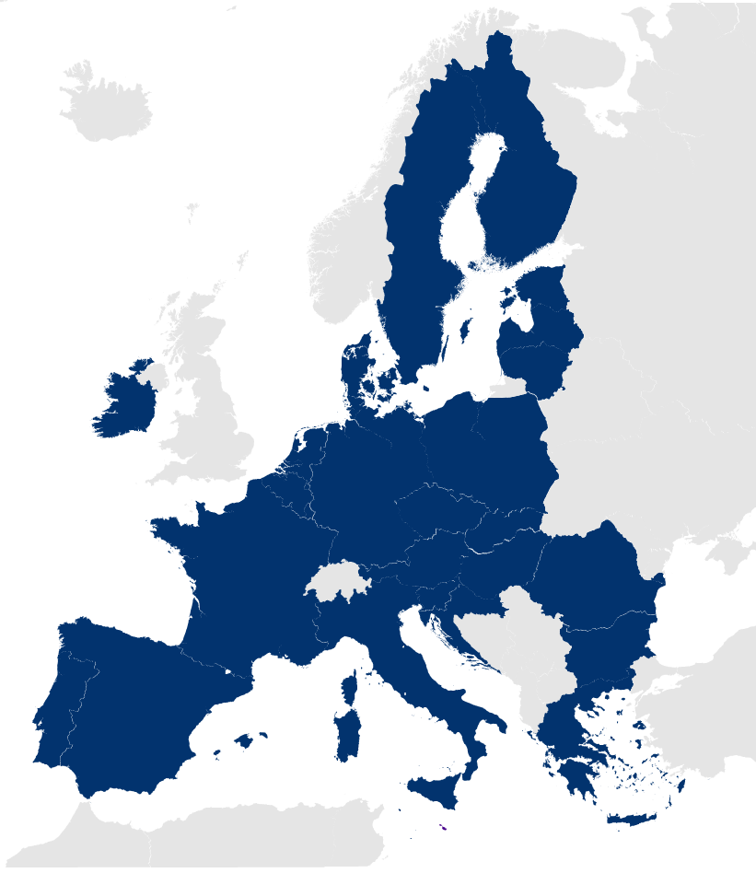
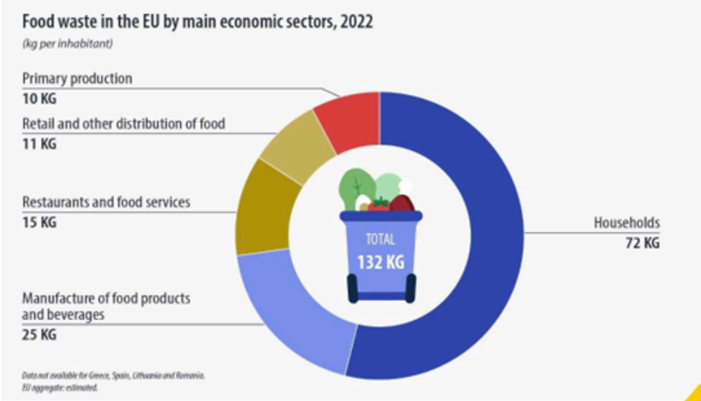
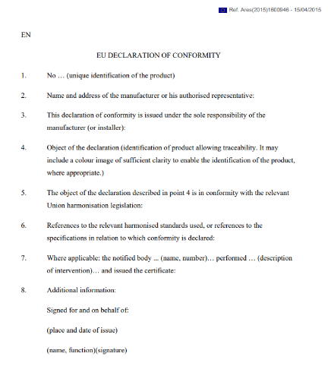

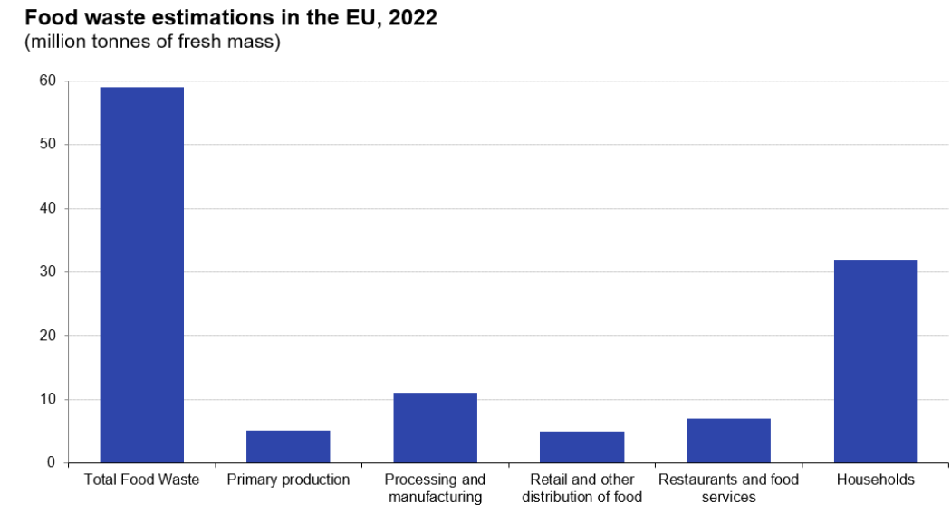




How does it work?
DPP Container
Origin
Disposal options
Instructions of use
DPP is accessible via a data carrier and supported by technical systems (web-portal; registry).
DPP data is product-group specific (toys, textiles, detergents etc.) and defined through secondary legislation processes.

Slide 15









Economic Operators collect/gather information related to their product to create the DPP
DPP Web
Portal
The Commission's web portal allows stakeholders to find links to DPPs, with access determined by their specific permissions.
The product’s DPP identifiers are created and the DPP is registered in the DPP Registry
Market Authorities can search the DPP and check whether the information is correct and compliant
The full DPP data is stored with the Economic Operators or DPP Service Providers servers
DPP
Registry
Decentralised Storage
DPP CONTENT
The data carrier links to the DPP product information and consumers can make a purchasing decision
Once the DPP exists and is registered in the DPP Registry, the product can be placed on the market
Recyclers and Repairers can search the DPP information via a data carrier
If a product is imported, customs authorities check the DPP provided by the economic operator.

Slide 16
Digital Product Passport
Objectives and expected benefits

Slide 17





Benefits for consumers, businesses & public authorities
Consumers
Businesses
Public Authorities
Digital instructions of use
Verified product data: origin, materials, sustainability, comparability
Product‑related services: use, repair, maintenance, accessories
Digitalised product information: reduced printing, shipping, storage costs
Centralised digital product data: simplified reporting
New business models: connected services via DPP, repair, maintenance, accessories
Automated compliance checks and reporting
Harmonised digital product data that allows to perform risk assessment processes
eSurveillance webcrawler integration: more effective detection of similar dangerous products
Notes:
Speaking points: main benefits one keyword for each

Slide 18

Supporting businesses along the implementation
The Commission plans to develop:
Technical guidance documentation for DPP registration and the use of the DPP registry
DPP readiness campaign to support the industry, including webinars and other events
Open-source tools to help companies (incl. SMEs) to create DPPs and validate their DPPs structure

Slide 19
Digital Product Passport
Linkages with the European Product Act

Slide 20

European Product Act (EPA)
The EPA is envisaged as a legislative package bringing together three closely linked pillars:
New Legislative Framework (NLF): Modernises EU product legislation governing market access, CE marking and conformity assessment to reflect digitalisation and the circular economy, including clearer rules for refurbished products.
Market Surveillance: Reinforces enforcement of EU product rules by national authorities and customs, improving coordination and effectiveness against unsafe and non‑compliant products, including those sold online or imported.
Standardisation: Updates the EU standardisation framework to ensure timely and coherent harmonised standards underpinning CE marking, conformity assessment and regulatory compliance across the single market.

Slide 21
DPP as part of EPA
Introducing horizontal DPP legal framework as part of the EU Product Act (EPA).​ This means harmonizing and clarifying the core DPP elements, including: ​
Decreased legal complexity
Simplified compliance rules for economic operators
Bringing cost-savings for manufacturers and public authorities
Consolidated data requirements through single reporting standard for SMEs across sectors
Ensuring a smooth implementation of the DPP
Future proofing the DPP framework
The introduction of these horizontal rules would not negatively impact the rollout of the DPP.

Slide 22
Digital Product Passport
Timeline and next steps

Slide 23




Timeline
June 2026
Implementing Act DPP Registry;
Implementing Decision
DPP Standards
July 2026
DPP Registry becomes operational
Q3 2026
European Product Act and Circular Economy Act – EC proposal
Q4 2026
Adoption of ESPR Delegated Act Iron & Steel;
Implementing Act for Batteries access rights
Q3 - Q4 2027
Adoption of ESPR Delegated Act on Textiles, Aluminium and Tyres
Q2 2027
Implementing Act
Digital credentials; Delegated Act for Unique identifiers, Horizontal Delegated Act for Repairability
February 2027
DPP becomes mandatory for Batteries
Q1 2027
Delegated Act DPP Service providers;
Delegated Act for Construction materials under CPR
2028
DPP becomes mandatory for Packaging, Iron & Steel and Construction materials;
Delegated Act for Furniture
2029
DPP becomes mandatory for ICT products, Tyres, Aluminium, Textiles, Detergents;
Delegated Act for Mattresses;
Horizontal Delegated Act for Recycled content
2030
DPP becomes mandatory for Toys

Slide 24
Concrete next steps
The EU Harmonised Standards undertaken by CEN-CENELEC to be all published.
Launch of the DPP registry in July 2026.
Certain types of big batteries are the first product category for which the DPP becomes mandatory in February 2027.
The DPP is being introduced for a wide range of other products, specified in ESPR Work Programme, from the end of 2027 onwards.
.

Slide 25
Digital Product Passport
Do you have any questions or comments?

Slide 26
Thank you!
Contact: GROW-DIGITAL-PRODUCT-PASSPORT@ec.europa.eu

